Slide 1
POL
Next Generation LAN Networks
Anovidan Investments Ltd
Introduction to Passive Optical LAN
Changing the Landscape of Enterprise Infrastructure

Slide 2

POL – ECO friendly solution
CAT3
Voice only
Serving 120 end-points
Capacity in Kbps
CAT5e
Data only
Serving 120 end-points
Capacity in Mbps
Single Mode Fiber
Voice, Data, Video & Other
Serves 128 with PON
Capacity measured in Tbps
POL
Next Generation LAN Networks
Anovidan Investments Ltd

Slide 3











Basic Premise of POL
POL
Next Generation LAN Networks
Anovidan Investments Ltd
IDF
Floor n
Office Space
Copper-based
Ethernet LAN
WLAN
Passive
Optical LAN
Fire Suppression
Long PoE
Cables
Fiber 32
Short PoE
Cables
MDF
HVAC
PON x
32
Short
CAT-5/6
Optical Line
Terminal
Long
CAT-5/6
Fiber 1
Access
Switches
Heavy Duty Cable Trays
Light weight or no Cable Trays
56
PON
Ports
Distribution
Switch
Multi-Mode Fiber
Floor 1
Fiber 8
WLAN
7000+
Ethernet
Ports
Served
PON 1
Long PoE
Cables
Short PoE
Cables
8
4-port
Optical Line
Terminals
Single-Mode
Fiber
4
(20km reach)
8
Fiber 1
Core
Router
8
8
1700+
ONTs
Access
Switches
WAN
AC
Heavy Duty Cable Trays
Short
CAT-5/6
Light weight or no Cable Trays
UPS
Long
CAT-5/6

Slide 4
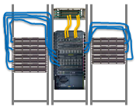


Traditional LAN (2.000 users)
POL (8.000 users)
90% space reduction
1 Rack
4x the number of users!
18 Racks
Less Energy, Less Space, More Scalable
POL
Next Generation LAN Networks
Anovidan Investments Ltd

Slide 5
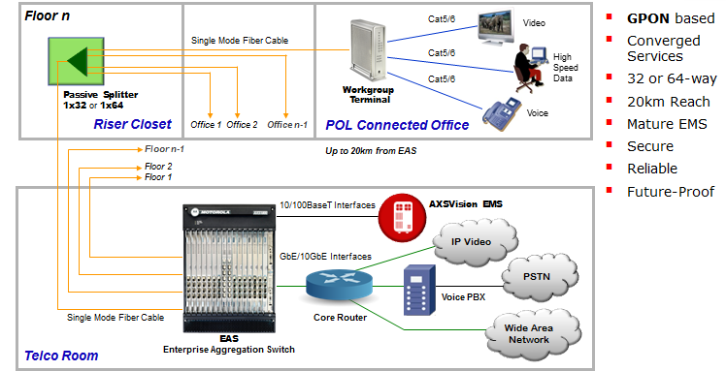
POL
Next Generation LAN Networks
Anovidan Investments Ltd
POL – GPON in Building Architecture

Slide 6
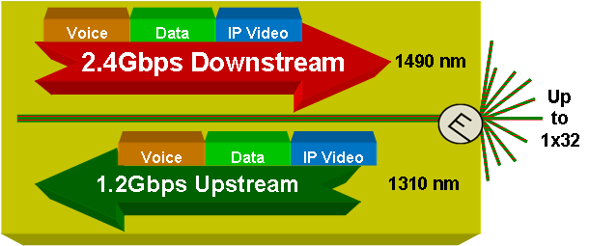
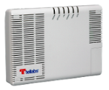
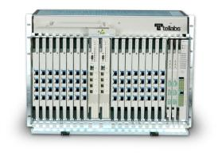
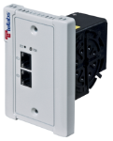



POL
Next Generation LAN Networks
Anovidan Investments Ltd
GPON
Passive Optical Network (PON)
Optical Network Terminals (ONT)
Single mode fiber
Single mode fiber
1G or 10G
Network
Uplinks
1490nm
20km/12mi to 30km/18mi
Optical Line Terminal (OLT)
1310nm
Optical Splitter
(1:32 or 1:16)
Passive Optical Network (PON)
Completely passive infrastructure
Single fiber carries multiple wavelengths
2.48 Gbps downstream
1.24 Gbps upstream
Serve Remote Buildings Up to 20Km to 30Km

Slide 7




GPON
POL
Next Generation LAN Networks
Anovidan Investments Ltd
0 – 20Km
Desktop
Terminal
(ONT)
Voice
OLT: Optical Line Terminal
Data
1:32
Switched Video
1490 nm
Analog &
QAM Video
1310 nm
MTU
Terminal
(ONT)
1550 nm
Each PON supports a single optical fiber carrying 2 wavelengths, a rate of 2.4G/1.2G, up to 64 end devices, and a maximum span of 20km
  1490 nm downstream (TDM) carrying Voice, Data and Switched Video traffic
  1310 nm upstream (TDMA) carrying Voice, Data and Video Signaling traffic
GPON Standard Supports Overlay Wavelengths within the 15xx range
  Currently used to support RF-based video delivery
  In the near future will be used to support DWDM services

Slide 8
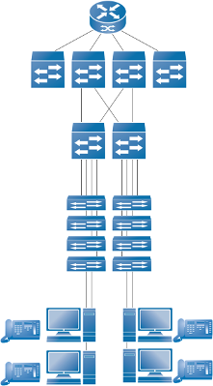



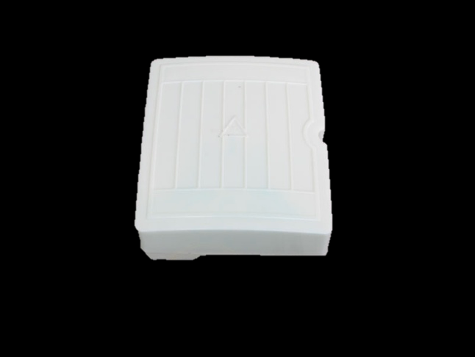
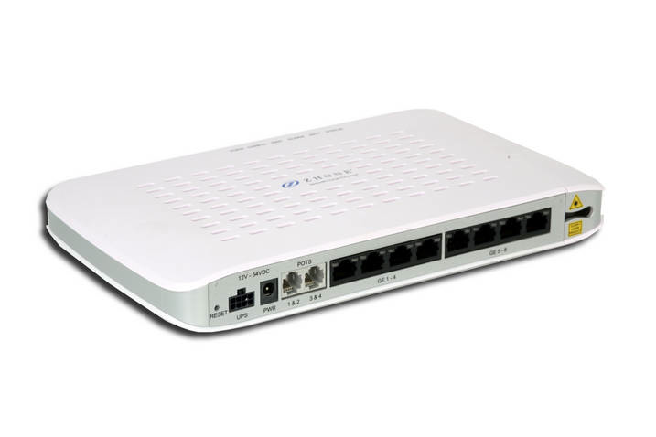



Next Generation of
Enterprise LAN
Present Method of Deployment
Layers of Routers & Switches
Zhone FiberLAN
Campus Aggregation
Zhone MXK
OLT
Building Aggregation
Passive
Network
zPON
Splitter
Communication Closet
Zhone zNID
ONT
End User
Zhone Confidential

Slide 9
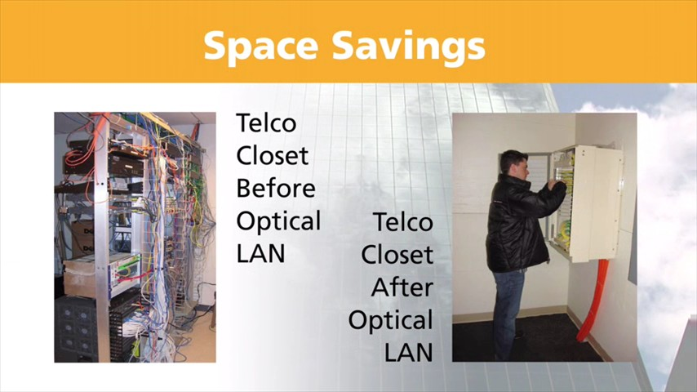
Footprint Savings
75 Users
250+ Users

Slide 10

Association for Passive Optical LAN
NEW YORK – August 6, 2013 – Corning, IBM, SAIC, TE Connectivity, Tellabs,
Zhone and 3M have formed the Association for Passive Optical LAN (APOLAN).
The association’s mission is advocating for the education and global adoption
of passive optical networks in the local area network (LAN) industry.
POL
Next Generation LAN Networks
Anovidan Investments Ltd

Slide 11
POL
Next Generation LAN Networks
Anovidan Investments Ltd
POL –Scalable & Future Proof
Single-mode fiber used to support advances future generations of PON technology:
  LAN network can be upgraded without new cable infrastructure deployment.
  Scalable infrastructure can support over 100Tbps bandwidth.
Traditional Ethernet Solution Lifespan
5-8 YEARS
Optical LAN Solution Lifespan
30 YEARS

Slide 12
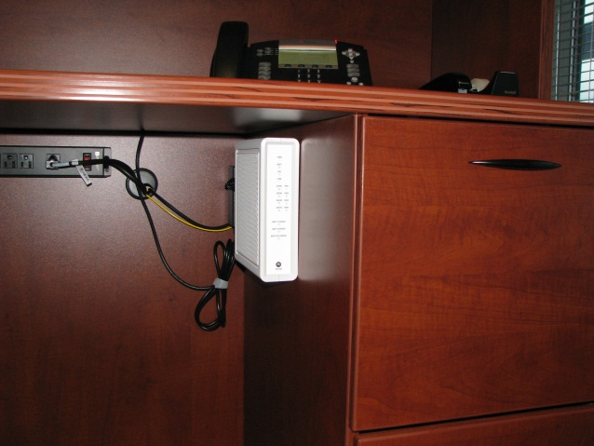
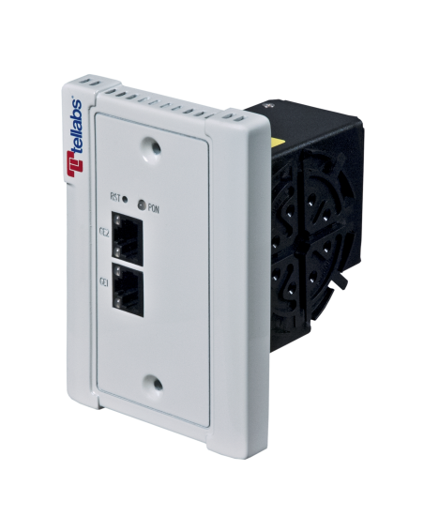
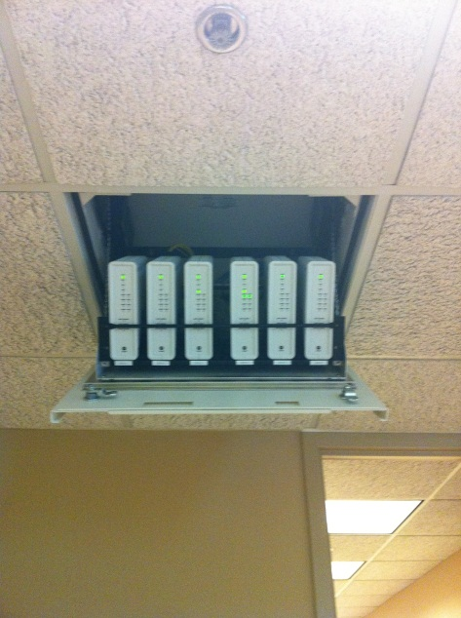
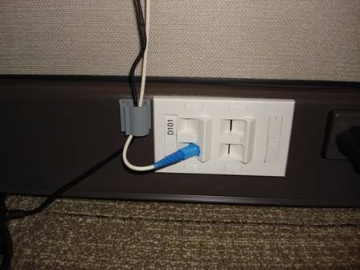
POL
Next Generation LAN Networks
Anovidan Investments Ltd
ONT Installation
_{ONT under-desk mount version}
_{ONT wall-mount version}
_{SECURE Wall Box version}
_{Appliance outlet}
_{ONT Zone Application}

Slide 13






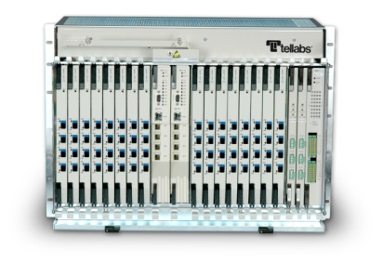
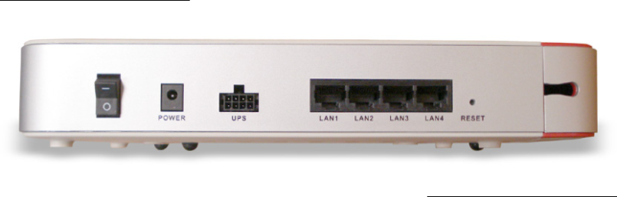

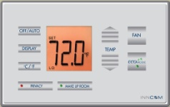
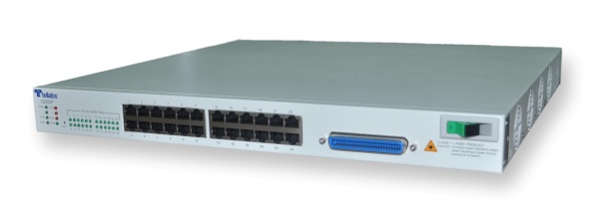


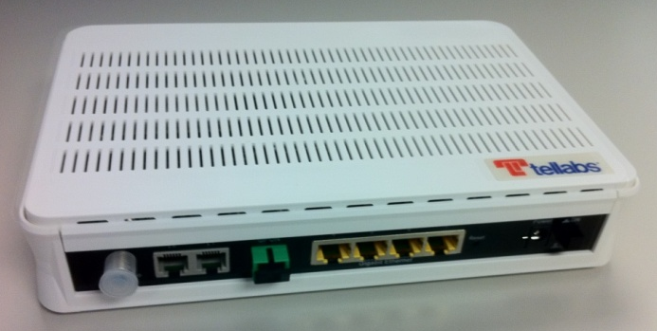


Passive Optical LAN
Building Service Integration
POL
Next Generation LAN Networks
Anovidan Investments Ltd
Desktop
Computer
Analog Voice
VoIP
Phone
WiFi
Access Point
Packet Voice
Building
Automation
Systems
PON
Splitter
IP / Ethernet
Data
Surveillance
Camera
IP Video
Video
Conferencing
RF Video

Slide 14
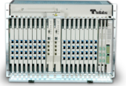



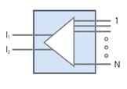
Redundancy
Type B PON redundancy
via 2:x ODN splitter
  A 2:x PON splitter provides both protection, redundancy and splitting functions
  Supported across different PON cards in same OLT or between different OLTs in geographically dispersed locations
  A means to provide fiber route diversity between OLT and 2:x ODN splitters
  Supported for 2:8, 2:16, 2:32 ODN splitters
2:32
Splitter
Block Diagram
2 x N Splitter
POL
Next Generation LAN Networks
Anovidan Investments Ltd
June 8, 2015
Tellabs Confidential Proprietary
14

Slide 15
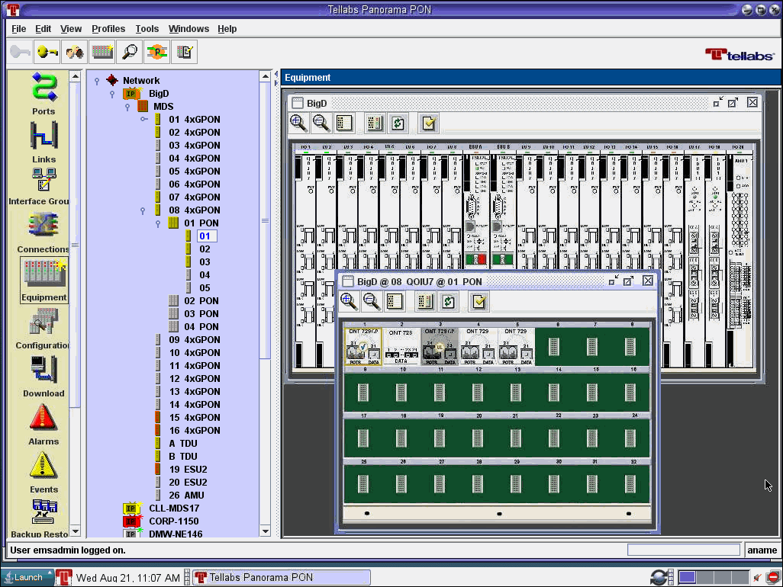
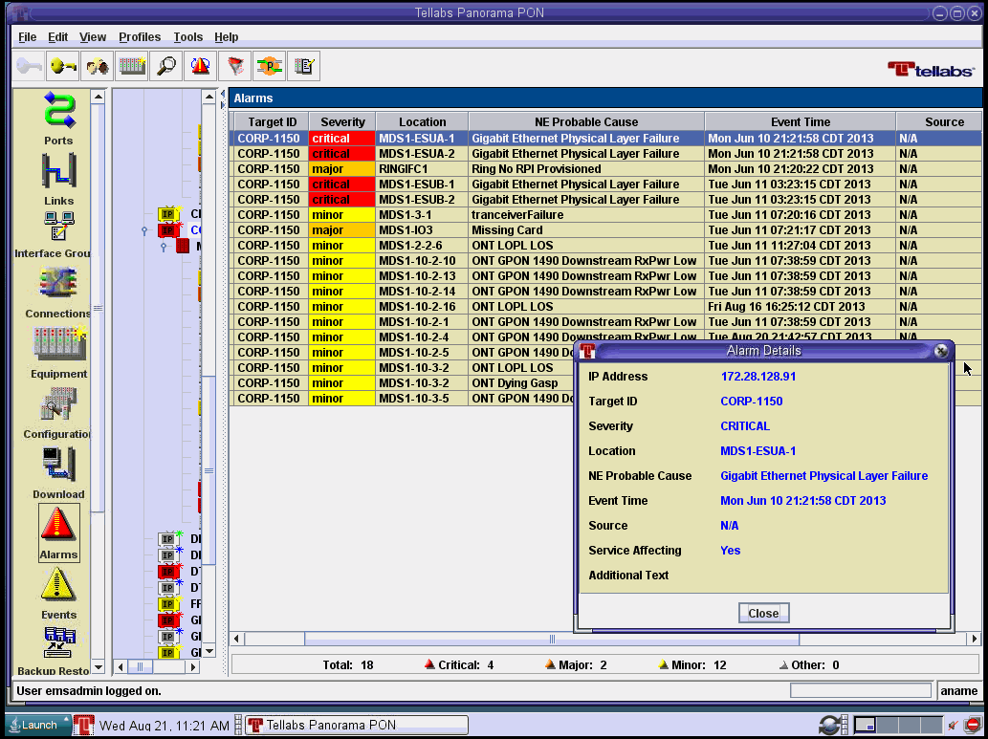
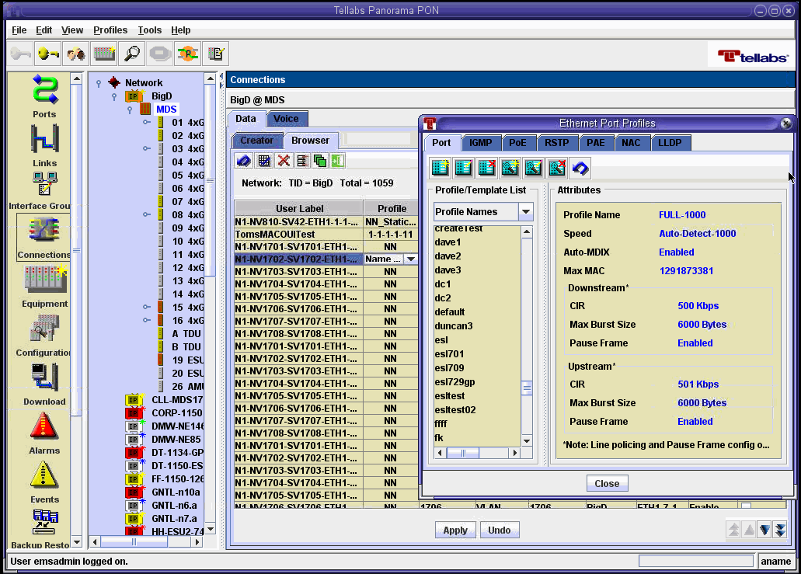
POL
Next Generation LAN Networks
Anovidan Investments Ltd
Tellabs® Panorama OLAN Manager
Faster Moves, Adds and Changes!
Centrally accessed element management provides efficiencies over CUI accessed at every OLT, VGW and ONTs
Panorama OLAN Manager key features
  Topology Manager ~ Offers a complete view of entire LAN and campus wide network
  Events/Alarm List Manager ~ Streamlines events/alarms monitoring and resolution
  Service Provisioning ~ Global profiles speed service provisioning and moves/adds/changes
  Security Manager ~ Role-based access, security privileges, activity logging which leads to better employee training and less rogue events
  Report Manager ~ Customized and automated report generation
  Scheduler for Automatic Backups ~ Scheduled and on-demand back-up and restoration of network configuration databases
  Online Help Utility ~ Hot-linked documentation for operational efficiency and better employee training
June 8, 2015
Tellabs Confidential Proprietary
15

Slide 16

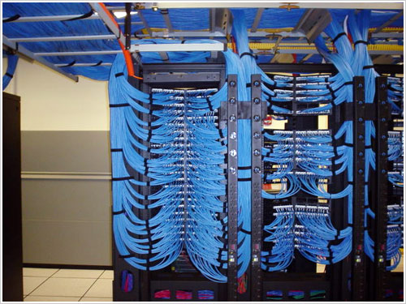
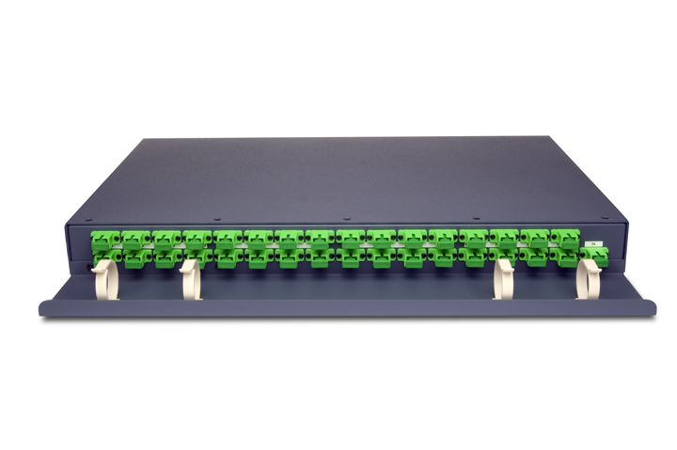
Space Requirements
From This
To That
Up to 90% Less space
No Need for floor closets

Slide 17


Security & Privacy
From This
To That
Cannot be tapped - No magnetic field
Encrypted

Slide 18

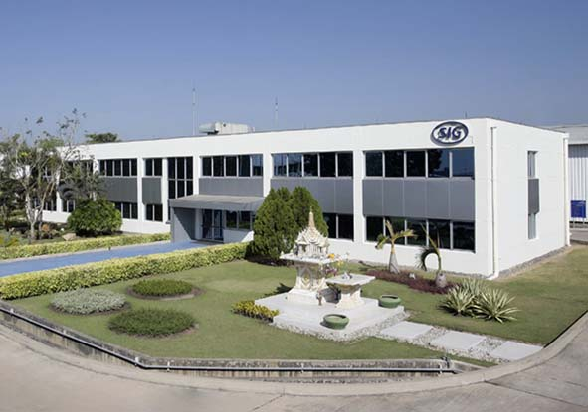
Maximum Distance
From This
To That
100 meters
20km

Slide 19
POL
Next Generation LAN Networks
Anovidan Investments Ltd
Stable
Carrier-class 99.999%/Five 9s availability = 5 minutes downtime per year
  One OLT, one SMF, one ODN splitter and one ONT achieves five 9s
  Equipment redundancy
    Common control, Ethernet switch units, network connectivity, power & fans
  On average, a business loses $5,600 per minute in an LAN outage
Network redundancy
  Dual homing to core routers
  Type-B PON redundancy
    PON ODN redundancy with geographically dispersed OLTs
    Fiber route diversity
    Achieve 99.9999%/six 9s availability with only 30 seconds network downtime annually
Graceful migration of future technology, fewer “rip and replace” events
  Analog voice → IP voice, and RF video → IP video, can be accommodated
  Single mode fiber infrastructure best future-proof choice today
  2.4GbE OLT/ONTs can migrate to 10GbE GPON per end-point
Improve LAN reliability and operational efficiencies
June 8, 2015
19

Slide 20
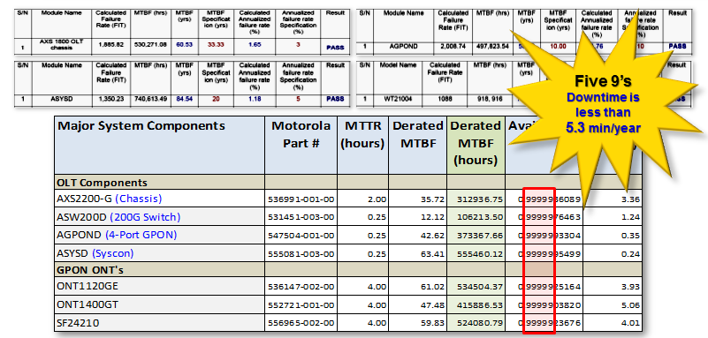
POL
Next Generation LAN Networks
Anovidan Investments Ltd
Reliability - MTBF

Slide 21



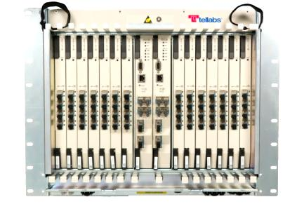


POL
Next Generation LAN Networks
Anovidan Investments Ltd
Availability and Resiliency
Availability and Resiliency
  OLTs have redundant power, cooling, logic/switching cards and backplanes
  OLT/ONT typically 5-9s (99.999%) available (5.25 minutes down time annually)
Reliability = > 99.938% (325 downtime Minutes/Year)
Legacy
Copper
Based
LAN
~ 5.4 hours
Reliability = > 99.961% (204 downtime Minutes/Year)
~ 3.5 hours
Source: Cisco Enterprise Campus 3.0 Architecture: Overview and Framework
Reliability = > 99.9999% (30 downtime Seconds/Year)
This architecture requires the use of two fiber NIC cards in each end user workstation
OLAN Reliability = > 99.999% (5.25 downtime Minutes/Year)
5-9s/5mins with less equipment and 6-9s/30seconds using Type-B PON redundancy!

Slide 22

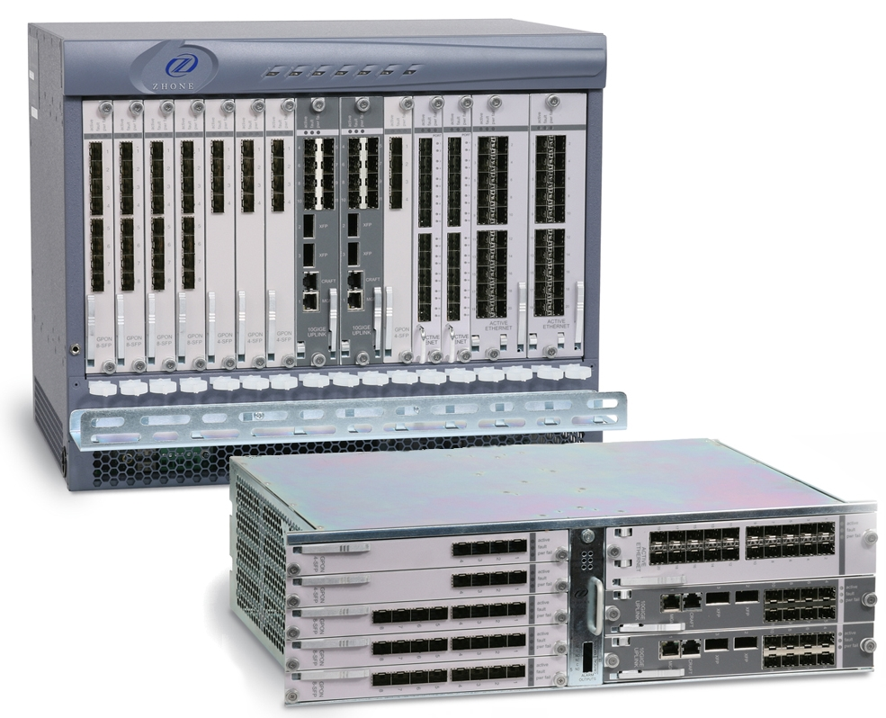
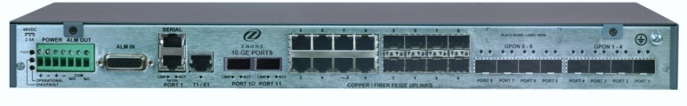
FiberLAN Access Concentrator Chassis
MXK 823, 819, 319, 198, 194
Scalability
High Bandwidth
Intelligence
High Reliability
Efficiency
Security
Performance
Notes:
Scalability, Bandwith, Intelligence, Reliability, Efficiency, Security, Performance => MXK

Slide 23
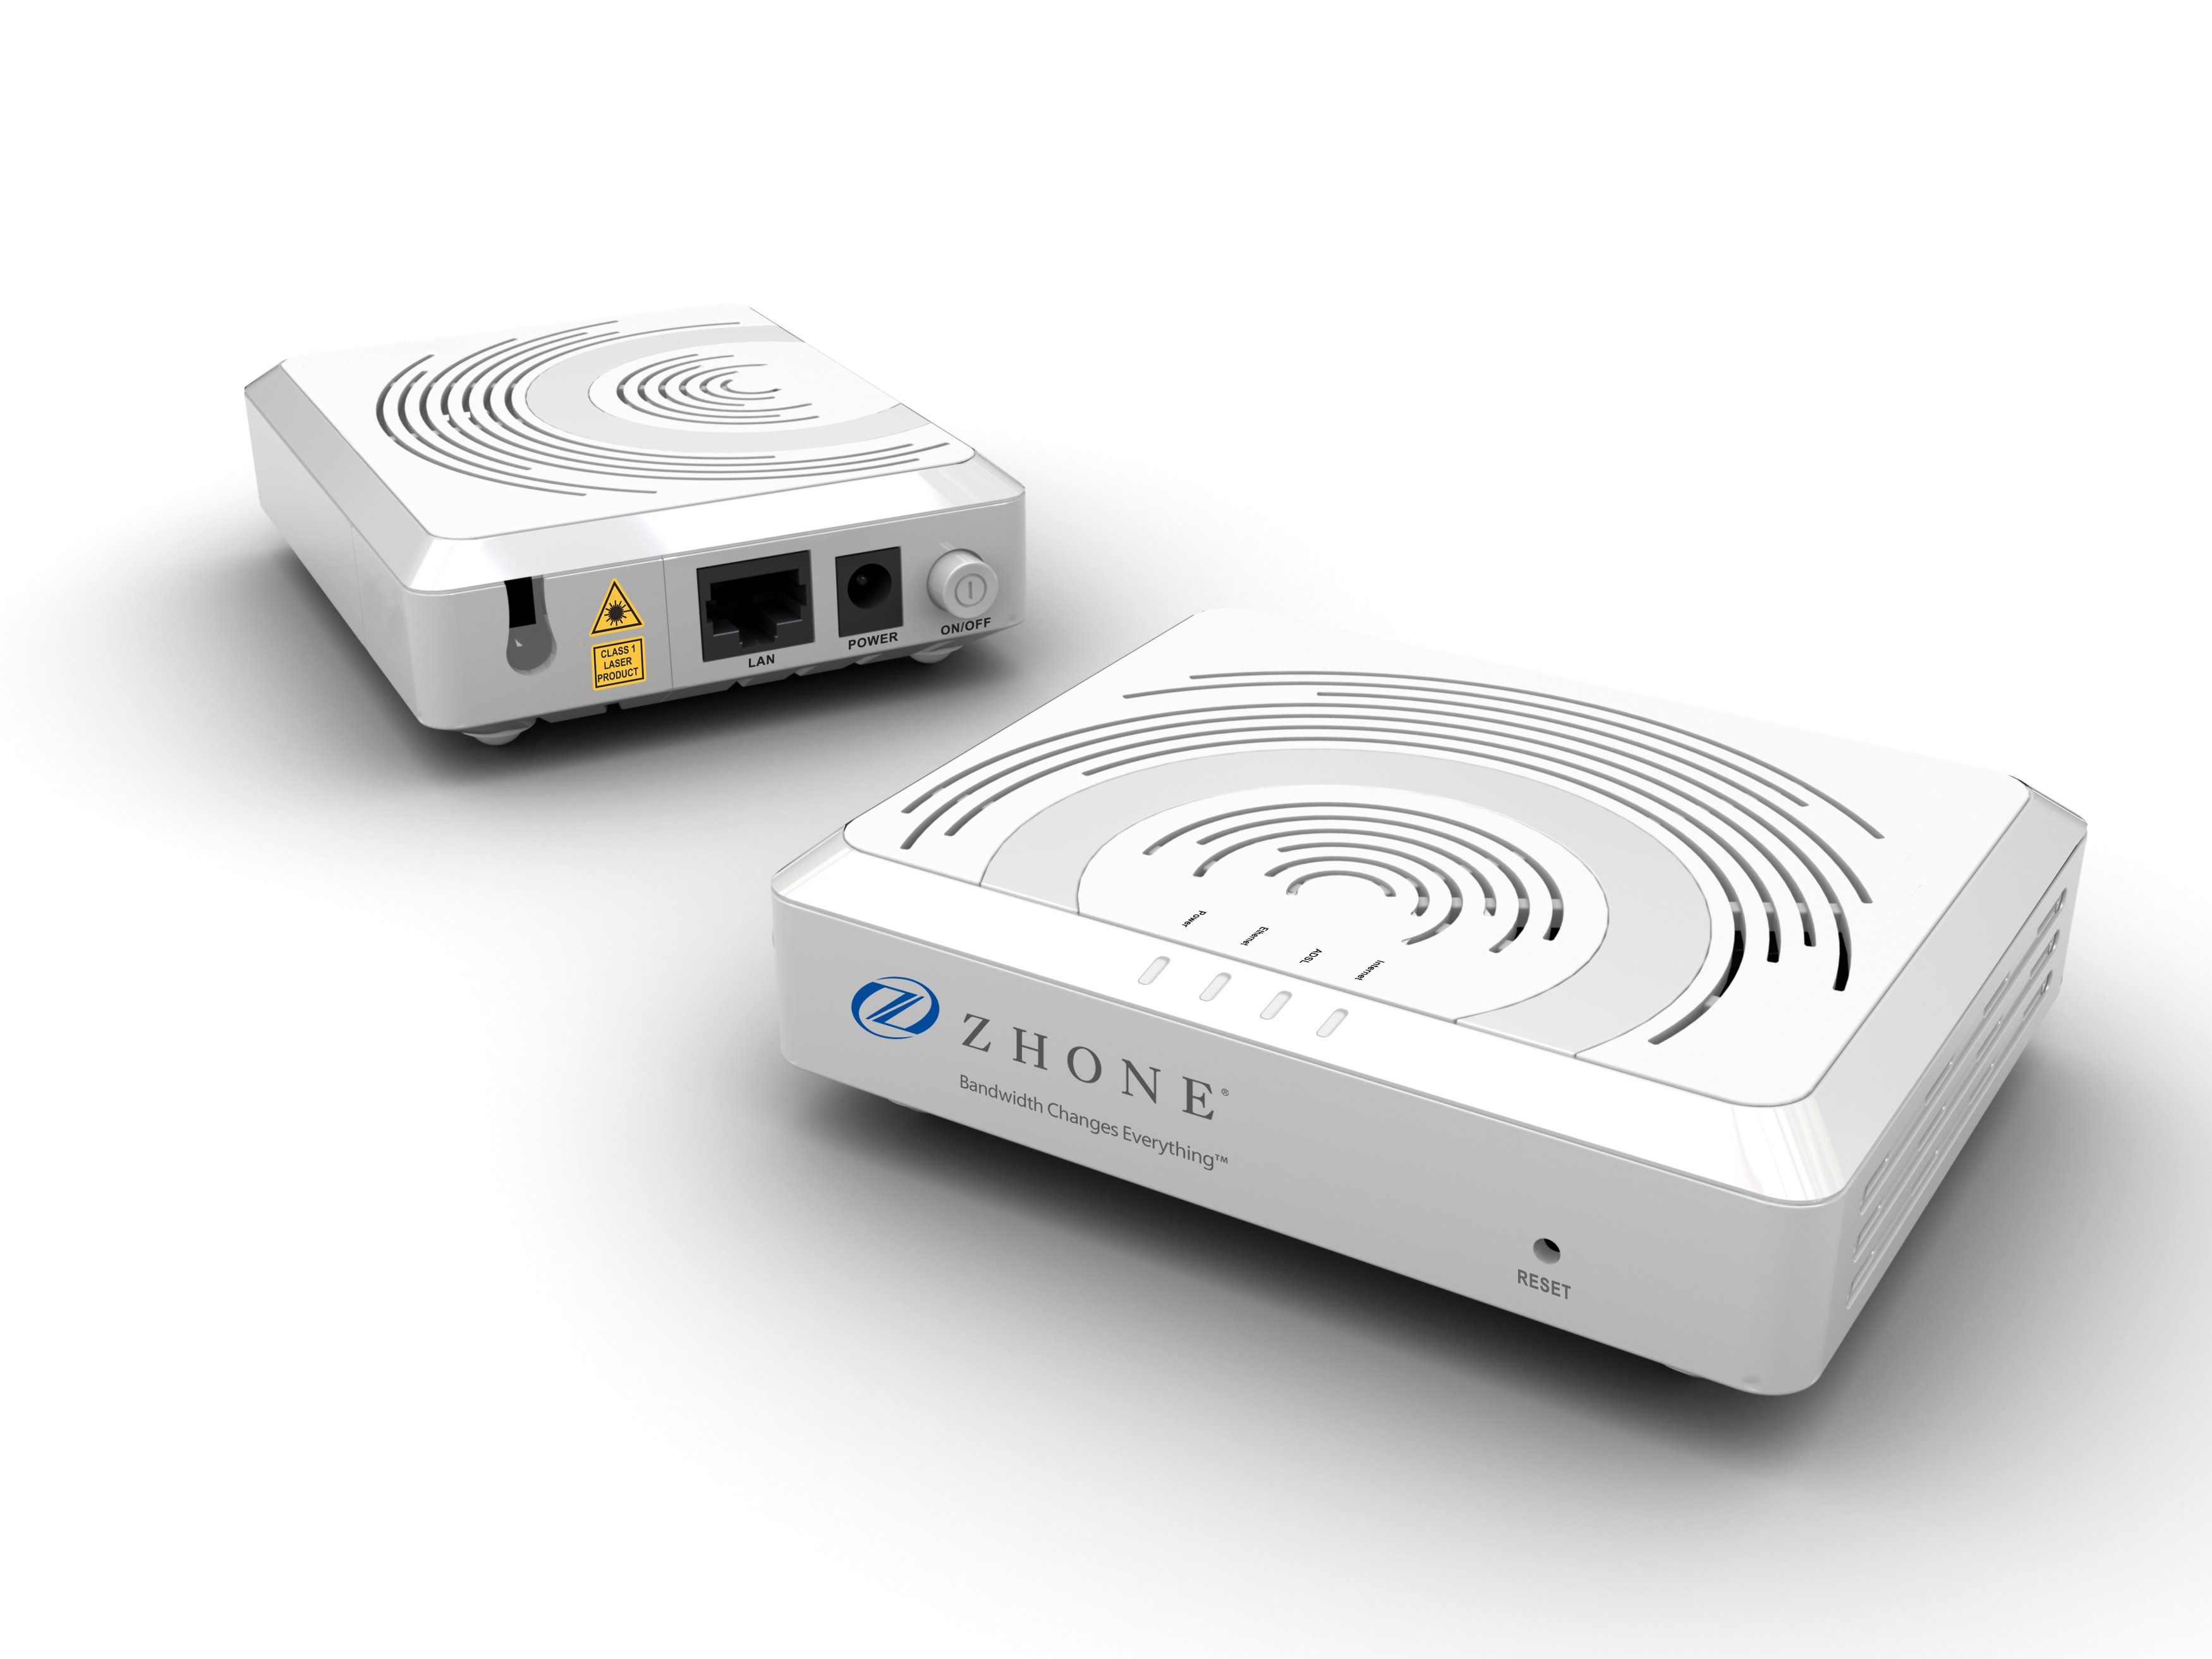
Indoor ONTs – 2300 Series
2301 ONT:
CE certification
-EU and -UK models available
Models Available | Description
ZNID-GPON-2301-00 (planned) | GPON Uplink, 1 GE with no Power Supply
ZNID-GPON-2301-EU | GPON Uplink, 1 GE with EU Power Supply
ZNID-GPON-2301-UK | GPON Uplink, 1 GE with UK Power Supply

Slide 24
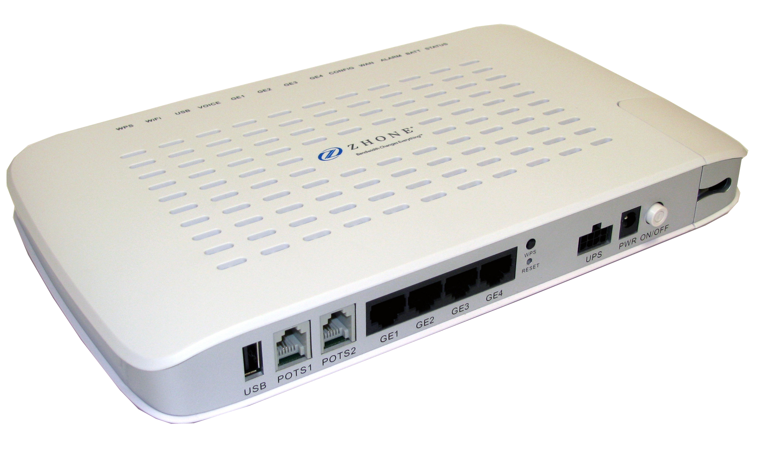
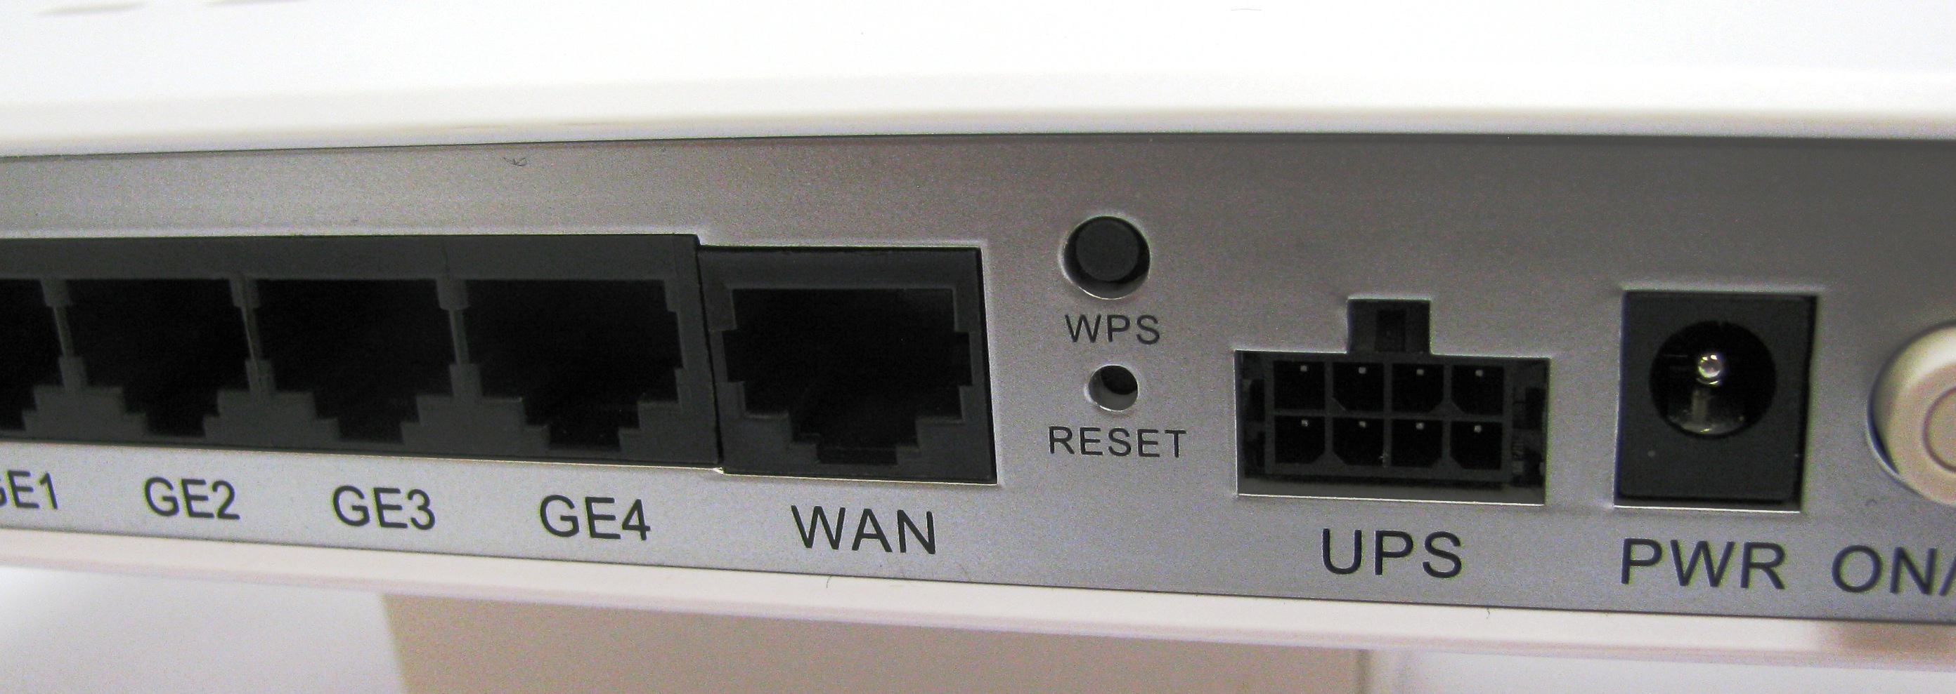
Indoor ONTs – 2400A Series
Model Group | Uplink Type |  |  |  | Ports
 | GPON | 1G Fiber | 100M Fiber | 10/100/1000 Copper | POTS | GigE | WiFi | RFV
2402A | -GPON | -GE |  |  |  | 2
2403A | -GPON |  |  |  |  | 2 |  | Yes
2424A | -GPON | -GE | -FE | -CU | 2 | 4
2425A | -GPON |  |  |  | 2 | 4 |  | Yes
2426A | -GPON | -GE | -FE | -CU | 2 | 4 | Int
2427A | -GPON |  |  |  | 2 | 4 | Int | Yes
2426A-EUR | -GPON |  |  |  | 2 | 4 | Rem
2427A-EUR | -GPON |  |  |  | 2 | 4 | Rem | Yes

Slide 25
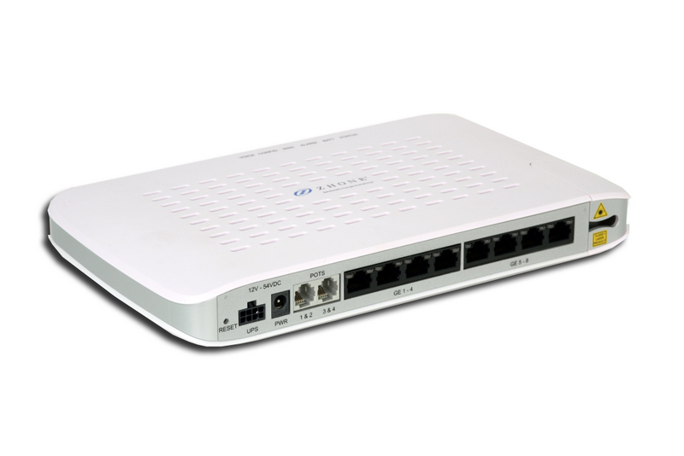
Indoor ONTs – 2600 Series
2600A/P/T
Model | Description | Model | Description
ZNID-GPON-2608T | GPON Uplink, 0 POTS, 8 GE with PoE | ZNID-GE-2608T | 20 km GE Uplink, 0 POTS, 8 GE with PoE
ZNID-GPON-2624A | GPON Uplink, 2 POTS, 4 GE | ZNID-GE-2624A | 20 km GE Uplink, 2 POTS, 4 GE
ZNID-GPON-2624P | GPON Uplink, 2 POTS, 4 GE (PoE) | ZNID-GE-2624P | 20 km GE Uplink, 2 POTS, 4 GE (PoE)
ZNID-GPON-2628A | GPON Uplink, 2 POTS, 8 GE | ZNID-GE-2628A | 20 km GE Uplink, 2 POTS, 8 GE
ZNID-GPON-2628P | GPON Uplink, 2 POTS, 8 GE (4 with PoE) | ZNID-GE-2628P | 20 km GE Uplink, 2 POTS, 8 GE (4 with PoE)
ZNID-GPON-2628T | GPON Uplink, 2 POTS, 8 GE with PoE | ZNID-GE-2628T | 20 km GE Uplink, 2 POTS, 8 GE with PoE
ZNID-GPON-2644A | GPON Uplink, 4 POTS, 4 GE | ZNID-GE-2644A | 20 km GE Uplink, 4 POTS, 4 GE
ZNID-GPON-2644P | GPON Uplink, 4 POTS, 4 GE (PoE) | ZNID-GE-2644P | 20 km GE Uplink, 4 POTS, 4 GE (PoE)
ZNID-GPON-2648A | GPON Uplink, 4 POTS, 8 GE | ZNID-GE-2648A | 20 km GE Uplink, 4 POTS, 8 GE
ZNID-GPON-2648P | GPON Uplink, 4 POTS, 8 GE (4 with PoE) | ZNID-GE-2648P | 20 km GE Uplink, 4 POTS, 8 GE (4 with PoE)
ZNID-GPON-2648T | GPON Uplink, 4 POTS, 8 GE with PoE | ZNID-GE-2648T | 20 km GE Uplink, 4 POTS, 8 GE with PoE
Model Tip: 26XXA = no PoE; 26XXP = 4 PoE; 26XXT = 8 PoE

Slide 26
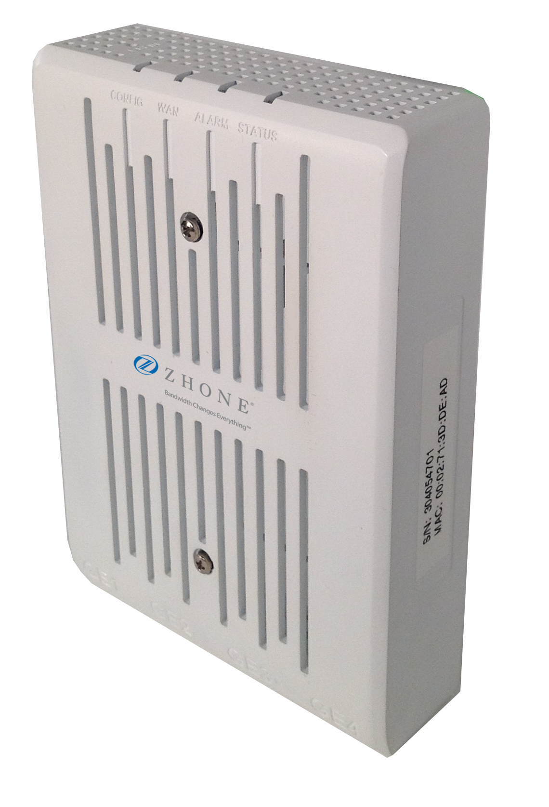
zNID 2800 Series
FiberJACK ONT’s
FiberJACK 2800 Series (Wall-Plate ONT)
2804P Models
  GE and GPON (SFF) Optics
  4 GE LAN ports
  Full RG functionality (3.0.x SW)
  LLDP-MED, 802.1X on Secure Access models
  LED Normal/Min/Dark modes
  Cover-Off detection switch & alarm
AC version
  Mounts in standard outlet box in wall
  100-240 VAC 50/60 Hz (3-wire pigtail)
  PoE (20W total power available for delivery)
DC version
  Outlet box NOT required (Low Voltage / Open Frame)
  Dual inputs: 2-wire direct power feed – OR – CAT5 PoE IN
  PoE (30W total power available for delivery)
Office/Enterprise/Government markets

Slide 27

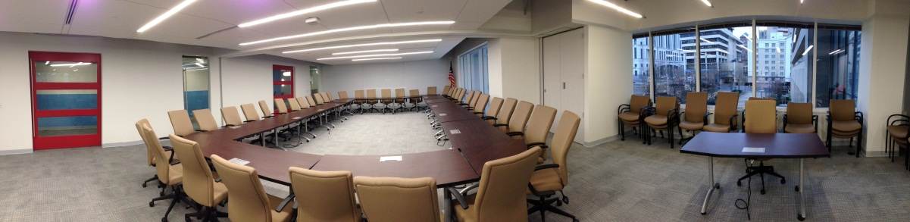


Passive Optical LAN
Market Adoption
POL
Next Generation LAN Networks
Anovidan Investments Ltd
Federal Government DoD / Civilian
Dept Energy Sandia National Lab
Dept Homeland Scty “St Elizabeth’s”
Health & Human Services
Intelligence Agencies
NASA Stennis Space Center
State Department, US AID
US Air Force Andrews AFB
US Air Guard Andrews AFB
US Army Honduras, FT Huachuca
US Army Reserves South East
USDA Forest Service
US Marine Corps
Camp Pendleton Hospital
MCB Quantico
MCB 29 Palms
Okinawa, Japan
MCD Albany, GA (pending)
Others (unannounced)
Commercial
TIA Headquarters
Deltek Corporation
San Diego Public Library
Schriever Air Force Base (housing)
Buccamment Bay Resort
Others (unannounced)
  Hotels, University
  Healthcare facilities
  Financial firms
San Diego
Public Library
TIA Headquarters
Sandia National Labs
Dept of Homeland Security
St. Elizabeth’s campus

Slide 28
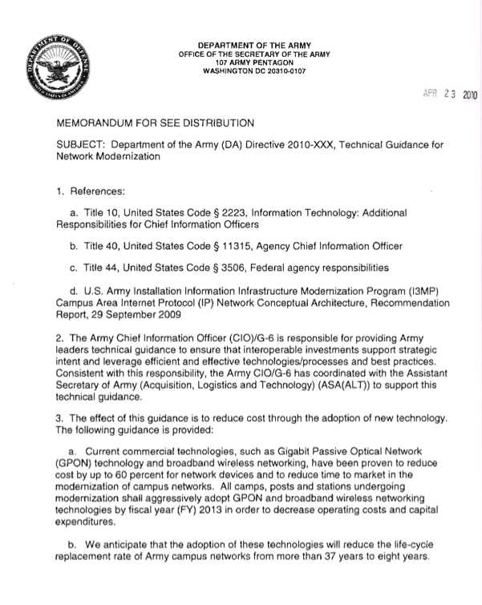

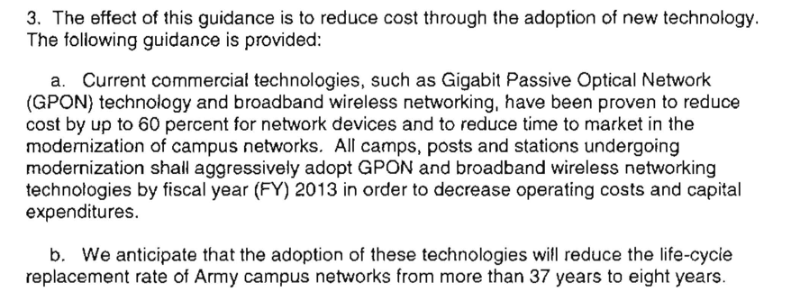
2010 Department of Army Directive
Technical Guidance for Network Modernization April 23, 2010
POL
Next Generation LAN Networks
Anovidan Investments Ltd

Slide 29
POL
Next Generation LAN Networks
Anovidan Investments Ltd
TCO – Case Review
Sandia National Laboratory
Sandia National Laboratory before Optical LAN
  13,000 users, 265 buildings & 600 active switches
  First cost installation around $3K to $5K per port
  Each switch in 3’Wx3’Dx7’H racks (600 total racks)
  Individual management across 265 buildings
After Tellabs Optical LAN
  14 active Optical LAN switches
    98% reduction
  Optical LAN OLT is the size of a microwave
    90% reduction in size
  Optical LAN will reduce total energy consumption by 65%
    Saves 1 million kilowatt hours per year
  First cost installation approximately $1.5K to $2K per port
    60% reduction in equipment and installation costs
  Centralized management of all users, buildings & Optical LAN equipment
Sandia National Laboratory
Sandia calculates $20M will be saved over 5 years compared to legacy copper based LAN!

Slide 30

POL
Next Generation LAN Networks
Anovidan Investments Ltd
POL – Key Value
Summary

Slide 31
POL – Target Users
Hospitals
Campuses
Universities
Cruise Ships
Hospitality
Government and Military
High Occupancy Buildings (Call Centers)
Multi-Tenant Units (Commercial and Residential)
POL
Next Generation LAN Networks
Anovidan Investments Ltd

Slide 32
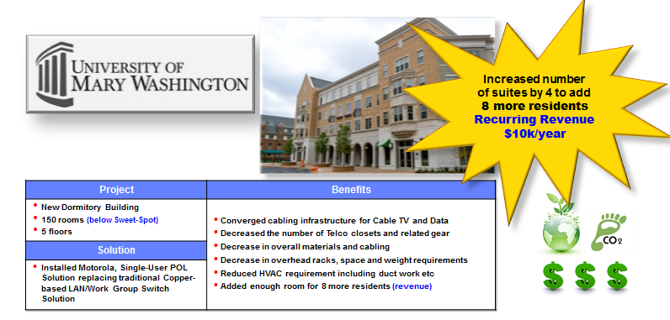
POL
Next Generation LAN Networks
Anovidan Investments Ltd
TCO – Case Review
University of Mary Washington

Slide 33
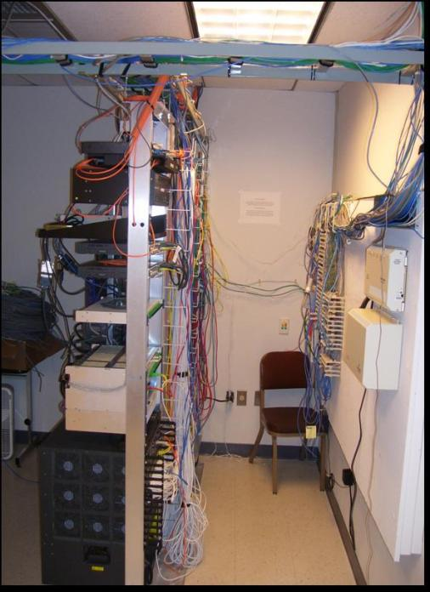
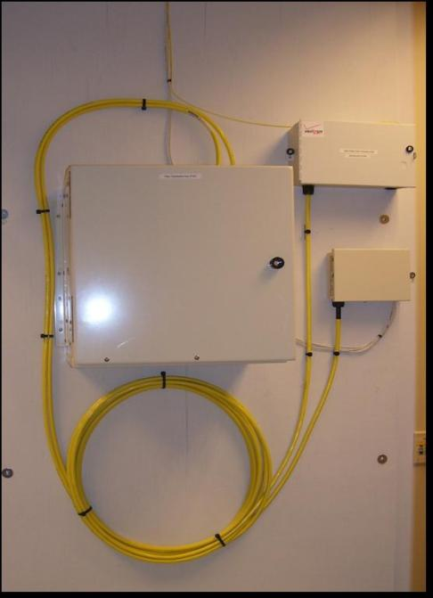
POL
Next Generation LAN Networks
Anovidan Investments Ltd
POL – Eliminates Cable Congestion
Before
After

Slide 34

POL
Next Generation LAN Networks
Anovidan Investments Ltd
TCO – Case Study
Russell Investments (8 floors)

Slide 35
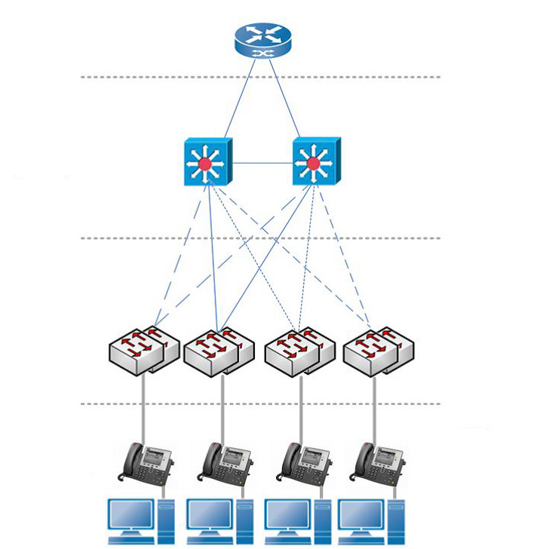
POL
Next Generation LAN Networks
Anovidan Investments Ltd
Traditional LAN
Core.
Layer 3
High Cost
High Power Consumption
High BTU Output
Requires HVAC
Large Rack-Space
Footprint
Distribution:
Layer2/3
High Cost
High Power Consumption
High BTU Output
Requires HVAC
Large Rack-Space
Footprint
Access:
Layer 2
Multiple Cables
High-Cost,
Large-Bundle Cabling
Edge
End user
workstations

Slide 36
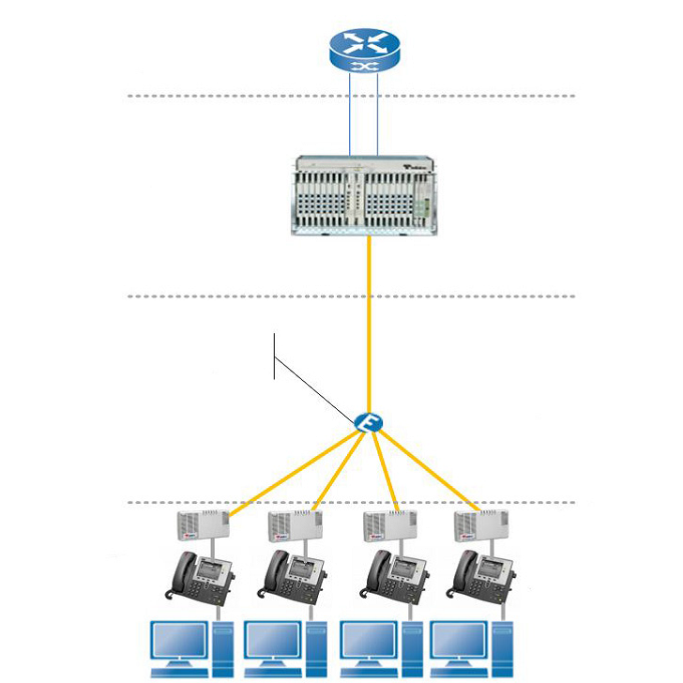
POL
Next Generation LAN Networks
Anovidan Investments Ltd
Passive Optical LAN
Core.
Layer 3
Centrally Managed
Better Cradle-to-Grave
“Five Nines” Reliability
Reduced Thermals
Reduced Rack-Space
Footprint
Distribution:
Layer2/3
1x32 Passive
Splitter
Low Cost
Zero Electronics
Zero Power Required
Zero HVAC Required
Zero Rack-Space
Access:
Layer 2
Low-Cost Small-
Bundle Cabling
PoE Enabled
Same Services &
Applications
as Active Ethernet
Edge
End user
workstations

Slide 37
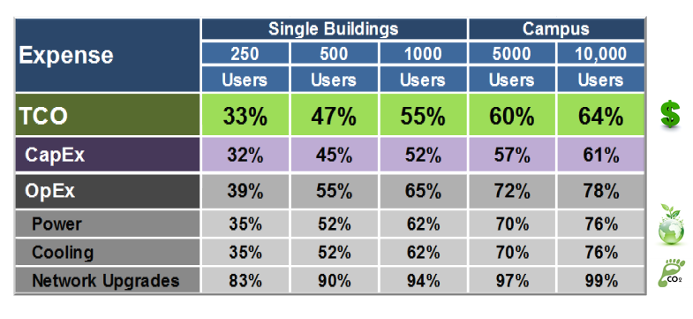
POL – Total Cost of Ownership (TCO)
POL
Next Generation LAN Networks
Anovidan Investments Ltd

Slide 38
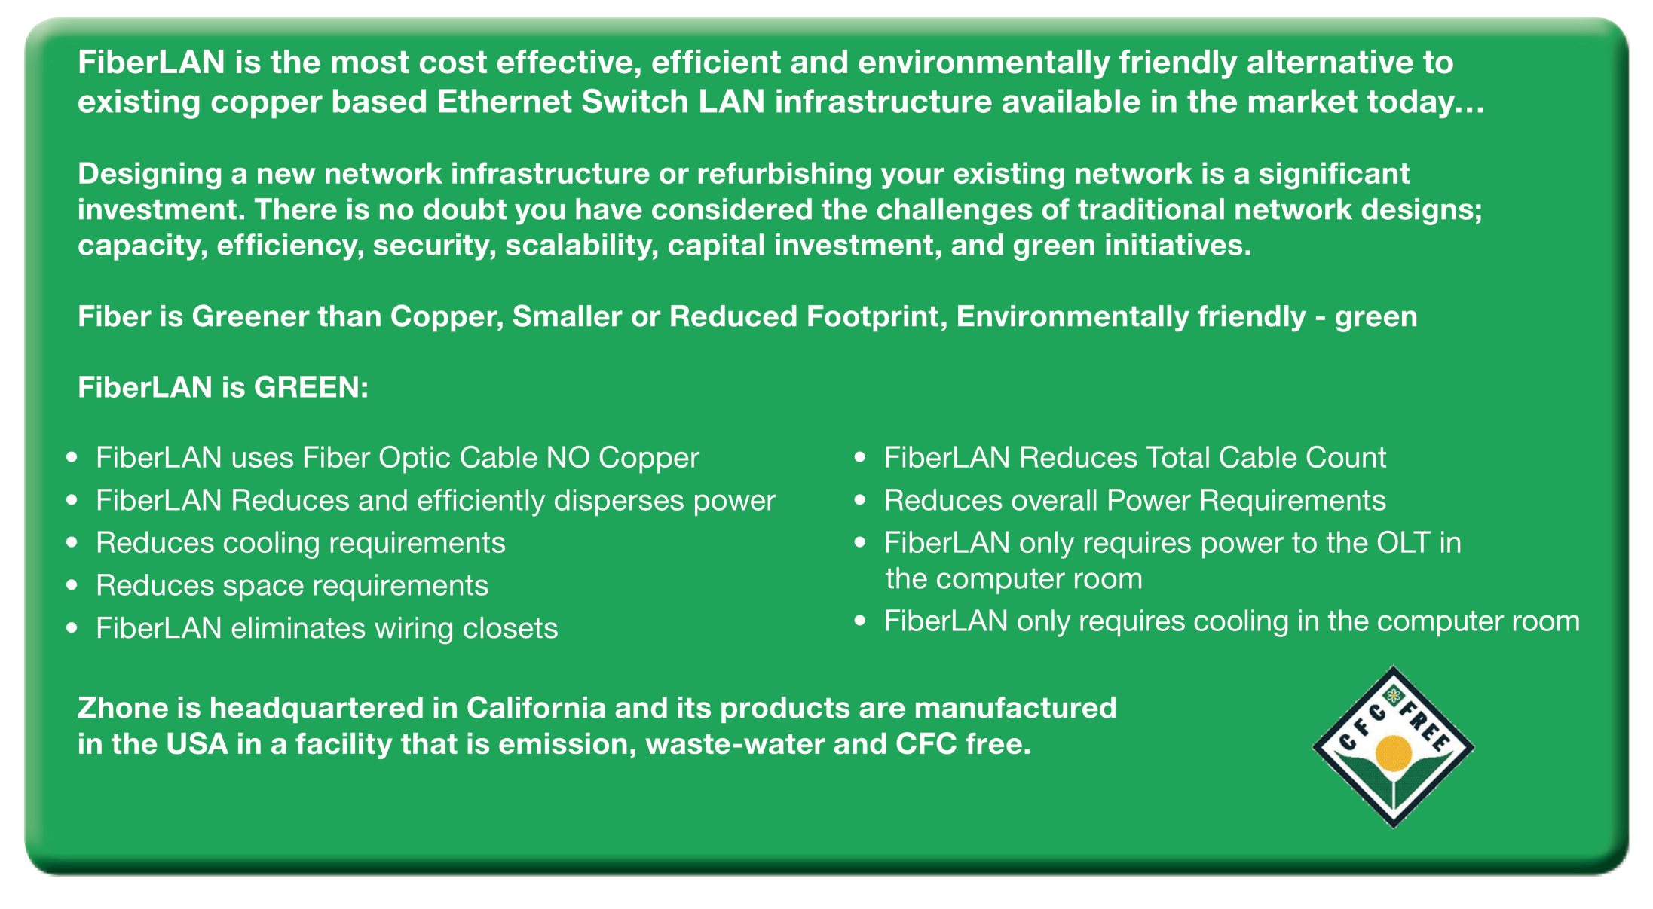
Zhone FiberLAN
A Green Technology Solution

Slide 39
Summary
FiberLAN Enables “Green-deployment” reduction in enterprise wide power and space consumption
FiberLAN provides Increased “Life-expectancy” of fiber based infrastructure 25 years vs. 10-15 years for copper
FiberLAN Reduces Management cost due to ease of use with Zhone EZ Touch and ZMS Network Management.
FiberLAN Reduces installation cost based on individual Fiber optic cable run supporting up to 64 ports or splits per PON (POL) port.
FiberLAN is highly secure
FiberLAN delivers “Unlimited Bandwidth” potential (GPON) today, upgrade to “wire speed” Active Ethernet if required in the future.

Slide 40
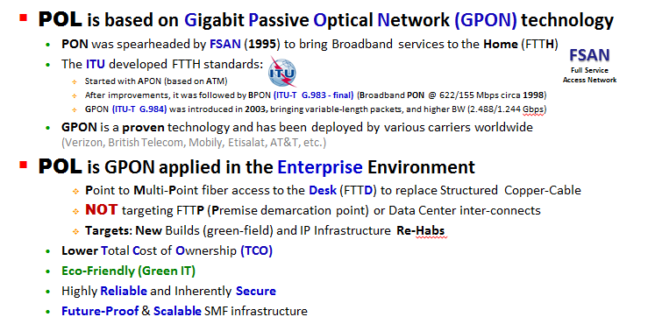
POL
Next Generation LAN Networks
Anovidan Investments Ltd
Brief History of POL

